Slide 1
Object Oriented Design & Programming
Unit-4
Object and Classes
OODP

Slide 2
🞄 Object oriented programming (OOP)
🞄 Encapsulates data (attributes) and functions (behavior)into
packages called classes
OOP
🞄 So, Classes are user defined (programmer defined) data types.
🞄 Data (data members)
🞄 Functions (member functions or methods)
🞄 In other words,
🞄 classes are “structures + functions”.

Slide 3
🞄 Once structure has been defined, we create variables of that type by using declarations that are similar to the built in type declarations.
🞄 Structure is unique feature of ‘C’ which provides method for packing together data of different types. A structure is a convenient tool for handling a group of data (logically related data items).
Structure Revisited
🞄 C++ supports all the features of structures defined in C But C++
expanded its capabilities further to suit its OOP philosophy.
🞄 C++ attempts to bring user defined data types as closer as possible to the built in data types and also provides facility to hide the data which is the main principle of OOP.

Slide 4
🞄 In C++, The keyword struct can be omitted in the declaration of
structure variables For example,
student A; //C++ declaration
🞄 Remember this is error in C.
🞄 C++ incorporates all these extensions in other user defined data type known as class There is very little syntactical difference between structure and class.
🞄 Structure
🞄 Member of Structure:
🞄 Variables
🞄 Class
🞄 Member of the class:
🞄 Variables
🞄 Functions
Structure Revisited

Slide 5
are public by default.
🞄 Members of a class are private by default and members of a structure
🞄 For Example:
🞄 In structure,
struct Test
Structure Vs. Class
{
int x;
//x is public
};
🞄 In Class,
class Test
{
int x;
};
//x is private

Slide 6
🞄 It is User Defined Datatype.
🞄 Class Contains Data Members and Member Function.
🞄 Building block of Object Oriented Programming is Class.
Class
🞄 Definition:-
🞄 A class is user-defined data type which binds data and its associated functions together.
🞄 A class has two parts:-
Class declaration
Class function definition

Slide 7
class class_name
{
private:
variable declaration;
Syntax of class
function declaration;
public:
variable declaration;
function declaration;
};
🞄 The binding of data and functions together in a single class-type
variable is referred as encapsulation.

Slide 8
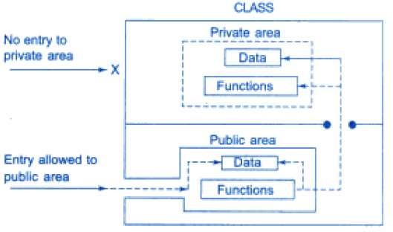
Data hiding in class

Slide 9
class Employee
{
private:
char name[20]; int age;
int salary;
Class is a keyword
Example
public:
void getData( ); void putData( );
};

Slide 10
class Employee
{
private:
char name[20]; int age;
int salary;
Class Name
Example
public:
void getData( ); void putData( );
};

Slide 11
class Employee
{
Body of Class
};
private:
char name[20]; int age;
int salary;
public:
void getData( ); void putData( );
Example

Slide 12
class Employee
{
private:
char name[20]; int age;
int salary;
Example
Access Specifiers
public:
void getData( ); void putData( );
};

Slide 13
class Employee
{
private:
char name[20]; int age;
int salary;
Private Data Members of class
Example
public:
void getData( ); void putData( );
};

Slide 14
class Employee
{
private:
char name[20]; int age;
int salary;
Example
public:
void getData( ); void putData( );
Public Member functions of class
};

Slide 15
class Employee
{
private:
char name[20]; int age;
int salary;
Example
public:
Semicolon, end of class scope
void getData( ); void putData( );
};

Slide 16
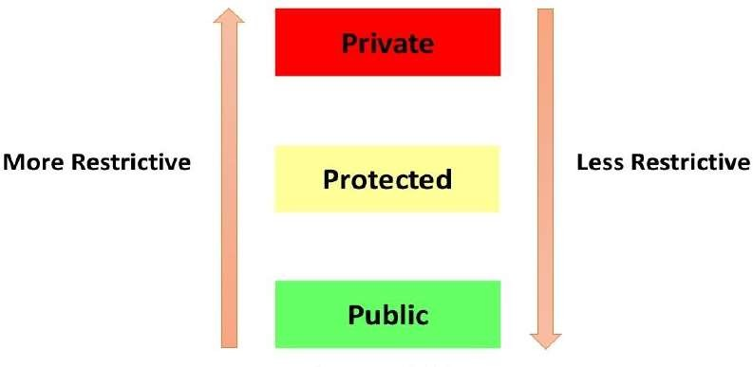
Access Specifiers

Slide 17
🞄 There can be three access specifiers in C++ :
🞄 Private : Private members can be accessed from other members
of the same class only or from the friends of class.
Access Specifiers
🞄 Protected : Protected members can be accessed from members of the same class, from the friend classes and also from members of the derived classes.
🞄 Public : Public members can be accessed from anywhere through the object of the class.
🞄 Private, Protected, Public are also called visibility labels.
🞄 In C++ data can be hidden by making private.

Slide 18
everyone.
🞄 All the class members declared under public will be available to
🞄 The data members and member functions declared public can be
accessed by other classes too.
🞄 Hence there are chances that they might change them.
🞄 So the key members must not be declared public.
public Access Specifier
class PublicAccess
{
public:
int x;
void display();
}
// public access specifier
// Data Member Declaration
// Member Function Declaration

Slide 19
that class.
🞄 No one can access the class members declared as private outside
🞄 If someone tries to access the private member, they will get a
compile time error.
🞄 By default class variables and member functions are private.
private Access Specifier
class PrivateAccess
{
private:
int x;
void display();
}
// private access specifier
// Data Member Declaration
// Member Function Declaration

Slide 20
🞄 It is similar to private, it makes class member inaccessible outside
the class.
🞄 But they can be accessed by any subclass of that class. (If class A is
inherited by class B, then class B is subclass of class A)
protected Access Specifier
class ProtectedAccess
{
protected:
int x;
void display();
}
// protected access specifier
// Data Member Declaration
// Member Function Declaration

Slide 21
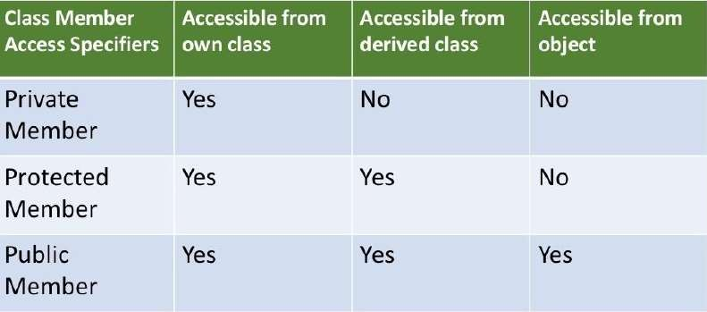
Access Specifiers

Slide 22
class A
{
private:
int x;
public:
int y;
};
Example of Private & Public
int main()
{
A a;
a.x =10;
a.y =20;
//Object creation
// Error
// Valid
cout<<“Value of x is:”<<a.x;
cout<<“Value of y is:”<<a.y;
// Error
// Valid
}

Slide 23
Class Example
#include<iostream> | void display()
using namespace std; | {
 | cout<<"Name is:"<<name<<endl;
class person | cout<<"Age is:"<<age;
{ | }
char name[30]; | };
int age;
public: | int main()
void getData() | {
{ | person p;
cout<<"Enter the name:"; | p.getData();
cin>>name; | p.display();
cout<<"Enter the age:"; | return 0;
cin>>age; | }
}

Slide 24
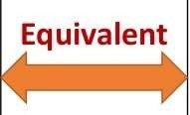
is “Private”.
🞄 When no access specifier mentioned then default access specifier
Default access Specifier
Class student
{
int no;
char name[20];
};
Class student
{
private:
int no;
char name[20];
};

Slide 25
🞄 A variable that is declared inside the method is called local
local variable :
variable.
🞄 A local variable is a variable declared within the body of a method
or within a block of code contained within the body of a method.
Different type of variable in C++
Member variable :
🞄 A member variable is a member of a class (class variable/static member variable) or a member of an object instantiated from that class (instance variable).
🞄 It must be declared within a class, but not within the body of a method of the class.

Slide 26
class sample
{
int no; static int y; void sum()
{
int x=5;
}
};
// member variable
// Static variable
// member function
Example of local and member variable
// Local variable
🞄 Member variables are declared inside a class but not inside a
method.
🞄 Local variables are declared inside a method including method
arguments.

Slide 27
method and no memory is allocated for them.
🞄 Class is a blue print which is containing only list of variables and
OR
🞄 Class declaration provides only template and does not create any
memory for the objects.
🞄 Once class has been declared, we can create object of that type by using class (like any other data type).
🞄 For example,
Creating Objects
Item x; //memory for x is created
Objects can also be created when class is defined
class Item
{
………
}x,y,z;

Slide 28
Difference between class and Object
 | Class | Object
1 | Class is a container which is collection of variables and methods | Object is an instance of class
2 | No memory is allocated at the time of declaration | Sufficient memory space will be allocated for all the variables of class at the time of declaration
3 | One class definition should exist only once in the program | For one class multiple objects can be created

Slide 29
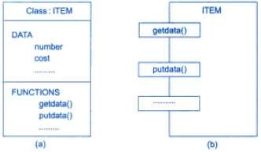
Representation of Class

Slide 30
🞄 The main() can not access number and cost variable of previous example directly. The following form at for calling a member function:-
Accessing Class Members
object_name.function_name (actual_arguments);
🞄 Example,
x.getdata(100,75.5);
🞄 Similarly,
x.putdata();

Slide 31
🞄 A variable declared private can be accessed using public member
🞄 A variable declared public can be accessed directly.
function of the class.
class xyz
{
int x;
public:
int z;
};
int main()
{
xyz p;
p.x=0; //error, x is private
p.z=1; //Allowed, z is public
}
Accessing Class Members

Slide 32
Member functions can be defined in two places:-
🞄 Outside the class definition
🞄 Inside the class definition
Defining Member Functions
🞄 Outside the class definition:
return-type class-name :: func-name(argument declaration)
{
// Function Body
}

Slide 33
void item :: getdata(int a, float b)
{
number=a;
cost=b;
}
void item :: putdata(void)
{
cout<<“Number:”<<number<<“\n”;
cout<<“Cost:”<<cost<<“\n”;
}
Outside the class definition

Slide 34
🞄 When a function is defined inside a class, it is treated as an
inline function.
class item
{
int number;
float cost;
public:
//variable declaration
// private by default
Inside the class definition
void getdata(int a, float b);
void putdata(void) // inline function
{
cout<<“Number:”<<number<<“\n”;
cout<<“Cost:”<<cost<<“\n”;
}
};

Slide 35
🞄 Several different classes can use the same function name. The membership label will resolve their scope.
Characteristics of Member Function
🞄 Member functions can access the private data of the same class. A nonmember function can not do so. (However, an exception to this rule is a friend function).
🞄 A member function can call another member function directly,
without using the dot operator.

Slide 36
class item
{
……………
……………
public:
void getdata (int a, float b); // function declaration
};
Making outside function Inline Function
inline void item :: getdata( int a , float b)
{
number = a;
cost = b;
}
// definition

Slide 37
class emp
{
public:
int salary;
//data member
//member function
void sal()
{
Sample Class Example
cout<<"Enter Salary";
cin>>salary;
cout<<"Salary is:"<<salary;
}
};
int main()
{
emp e; e.sal();
// Creating an object of emp class
// calling the function using object of emp class
}

Slide 38
🞄 A member function of a class can be called only by an object of that class using dot operator. However there is an exception to this.
Nesting of Member Function
🞄 A member function can be called using its name inside another member function of the same class. This is called nesting of member functions.

Slide 39
class set
{
void set :: input()
{
cout<< "Input values of m and n”;
cin>>m>>n;
}
void set :: display()
{
cout << "largest value ="<< largest();
//calling member function
}
int main()
{
set A;
A. input();
A. display();
}
int m, n;
public:
void input(); void display(); int largest();
Nesting of Member Function
};
int set :: largest()
{
if(m >= n)
return (m);
else
return(n);
}

Slide 40
class sample
{
int m;
void read();
public:
void update(void);
void write (void);
};
void sample :: update(void)
{
read();
}
int main()
{
sample s1; s1.read();
/*won’t work because object cannot access private member But following will work*/
s1.update();
}
Private Member Function

Slide 41
🞄 Member functions are created and placed in the memory space only once when they are defined as a part of a class specification.
Memory Allocation for Objects
🞄 Since all the objects belonging to that class use the same member functions, no separate space is allocated for member functions when the objects are created.
🞄 Only space for member variables is allocated separately for each
object.

Slide 42
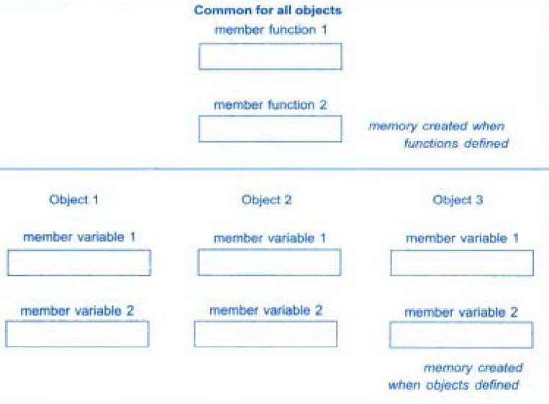
Memory Allocation for Objects

Slide 43
of a static member variable are similar to that of a static variable.
🞄 A data member of a class can be qualified as static. The properties
🞄 Certain special characteristics of a static member variable are
given below:
Static Data Members
It is initialized to zero when the first object of its class is created. No other initialization is permitted.
Only one copy of that member is created for the entire class and is shared by all the objects of that class, no matter how many objects are created.
It is visible only within the class, but its lifetime is the entire
program.

Slide 44
outside the class definition.
🞄 Type and scope of each static member variable must be defined
🞄 This is necessary because the static data members are stored
separately rather than as a part of an object.
🞄 Since they are associated with the class itself rather than with any class object, they are also known as class variables.
🞄 Static variables are normally used to maintain values common to
the entire class.
🞄 Example: A static data member can be used as a counter that
records the occurrences of all the objects.
Static Data Members

Slide 45
#include <iostream>
using namespace std;
int item :: count;
int main()
{
item a, b, c;
a.getcount();
b.getcount();
c.getcount();
class item
{
static int count;
int number;
public:
void getdata(int a)
{
number= a;
count ++;
}
void getcount(void)
{
cout<<“count: “<< count << “\n";
}
};
//count is initialized to 0
//display count
Static Data Members Example
a.getdata(100); b.getdata(200); c.getdata(300);
cout<< “After reading data” << "\n”;
a.getcount();
b.getcount();
c.getcount();
//display count
}

Slide 46
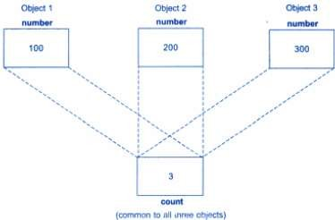
Sharing of static data member
🞄 While defining a static variable, some initial value can also be
assigned to the variable.
🞄 Example:
🞄 int item :: count= 10;

Slide 47
🞄 A static function can have access to only other static members
🞄 Characteristics of static member functions:-
(functions and variables) declared in the same class.
🞄 A static member function can be called using the class name
(instead of its objects). As follows:-
Static member functions
🞄 class name :: function_name();

Slide 48
#include <iostream> using namespace std; class test
{
int code;
static int count;
public:
void setcode(void)
{
code = ++count;
}
void showcode()
{
//static member variable
Static member functions Example
cout<< “object number: “ << code << “\n”;
}
static void showcount() // static member function
{
cout<< “count: “ << count << “\n‘’;
}
};

Slide 49
int test :: count;
int main()
{
test t1, t2;
t1.setcode();
t2. setcode();
test :: showcount();
test t3;
t3 .setcode();
test :: showcount();
t1. showcode(); t2. showcode(); t3. showcode();
return 0;
}
Static member functions Example
//accessing static function

Slide 50
🞄 We know that an array can be of any data type including struct.
Similarly, we can also have arrays of variables that are of the type
class.
🞄 Such variables are called arrays of objects.
🞄 Example:
Array of Objects
class employee
{
char name[30];
float age;
public:
void getdata(void); void putdata(void);
};

Slide 51
🞄 The identifier employee is an user-defined data type and can be used to create objects that relate to different categories of the employees. Example:
🞄 employee manager[3];
🞄 employee foreman[15];
🞄 employee worker[75];
// array of manager
// array of foreman
// array of worker
Array of Objects
🞄 The manager contains three objects (managers), namely,
manager[0], manager[1] and manager[2], of the employee type.
🞄 Statement - manager[i].putdata( );
🞄 will display i^{th} element of manager array.

Slide 52
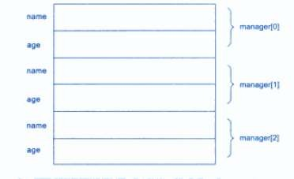
🞄 Storage of data items of an object array
Array of Objects

Slide 53
argument in following two ways:
🞄 Like any other data type, an object may be used as a function
Objects as Function Arguments
A copy of the entire object is passed to the function.
Only the address of the object is transferred to the function.
🞄 The pass by reference method is more efficient since it requires to
pass only the address of the object not the entire object.

Slide 54
🞄 Addition of time in hours and minute format
#include<iostream>
using namespace std;
class time
{
int hours, minutes;
public:
void gettime(int h, int m)
{
hours = h; minutes = m;
}
void puttime(void)
{
cout<<hours<<“hours and”; cout<<minutes<<“minutes \n”;
}
void sum(time, time);
//declaration with objects and arguments
};
void time :: sum(time t1, time t2)
{
minutes = t1.minutes+t2.minutes;
hours = minutes/60; minutes = minutes%60; hours += t1.hours+t2.hours;
}
Objects as Function Arguments Example

Slide 55
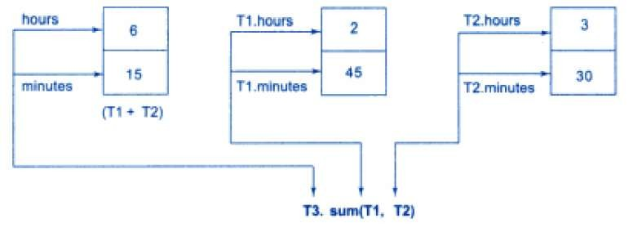
Objects as Function Arguments Example
int main()
{
time T1, T2, T3; T1.gettime(2,45); T2.gettime(2,45); T3.sum(T1, T2);
cout<<“T1 = ”; T1.puttime(); cout<<“T2 = ”; T2.puttime(); cout<<“T3 = ”; T3.puttime();
return 0;
}
//get T1
//get T2
// T3 = T1+T2
//display T1
//display T2
T1= 2 hours and 45 minutes T2 = 3 hours and 30 minutes T3 = 6 hours and 15 minutes
//display T3

Slide 56
🞄 A non-member function cannot have access to the private data of a class.
🞄 However there could be a situation where we would like two classes to share a particular function.
Friend Function
🞄 For example, consider a case where two classes, manager and scientist, have been defined.
🞄 We would like to use a function income_tax() to operate on the
objects of both these classes.
🞄 In such situations, C++ allows the common function to be made friendly with both the classes, there by allowing the function to have access to the private data of these classes. Such function need not to be member of any of these class.

Slide 57
the scope resolution operator.
🞄 The function definition does not use either the keyword friend or
🞄 Function declared with friend keyword is a friend function. It can
be friend of any number of class.
🞄 A friend function, although not a member function, has full access
rights to the private members of the class.
Friend Function
classABC
{
……….
………
public:
………
friend void xyz (void);
};
//declaration

Slide 58
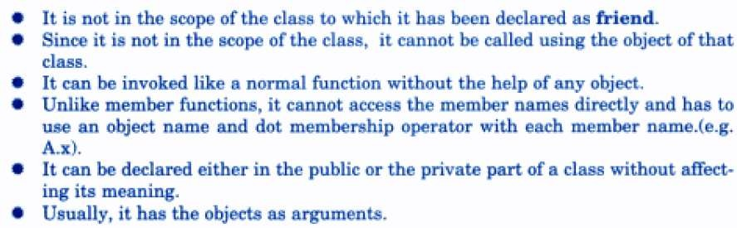
🞄 Special Characteristics of Friend Function:
Friend Function

Slide 59
#include <iostream> using namespace std; class sample
{
int a,b; public:
void setvalue()
{
a = 25;
b= 40;
}
friend float mean(sample s);
};
float mean(sample s)
{
return float(s .a + s.b)/2.0;
}
int main()
{
sampleX;
X.setvalue();
// objectX
cout<< “Mean value = “; cout<< mean(X) << "\n“;
return 0;
Friend Function
}
Mean value = 32.5

Slide 60
🞄 Member functions of one class can be friend function of another class In such cases, they are defined using scope resolution operator as shown below.
🞄 We can also declare all the member functions of one class as the friend functions of another class. In such cases, the class is called a friend class.
Friend Function
class X
{
………
int fun 1();
// member function of class x
………
}
class Y
{
………
friend int x::fun 1();
// function of class x is friend of class y
………
}
class Z
{
……….
friend class x ;
// all member functions of x are
// friends to Z
} ;

Slide 61
Friend function Example
#include <iostream> |  | void max(XYZ m, ABC n)
using namespace std; |  | {
class ABC; // Forward declaration |  | if(m.x >= n.a)
class XYZ |  | cout<< m.x;
{ |  | else
int x; |  | cout<< n.a;
public: |  | }
void setvalue(int i) {x = i;}
friend void max(XYZ, ABC); |  | int main()
}; |  | {
// // |  | ABC abc;
class ABC |  | abc.setvalue(10);
{ |  | XYZ xyz;
int a; |  | xyz.setvalue(20) ;
public: |  | max(xyz, abc);
void setvalue(int i) {a= i;} |  | return 0;
friend void max(XYZ, ABC); |  | }
};

Slide 62
🞄 A function cannot only have objects as arguments but also can return them.
class time
{
int hours; int minutes;
public:
void gettime(int h, int m)
{
hours = h; minutes = m;
}
void puttime(void)
{
cout<<hours<<“hours and”;
cout<<minutes<<“minutes \n”;
}
friend time sum(time, time);
//declaration with objects and arguments
};
time sum(time t1, time t2)
{
time t3;
t3. minutes = t1.minutes+t2.minutes;
t3. hours = t3.minutes/60; t3.minutes = t3.minutes%60; t3.hours += t1.hours+t2.hours; return (t3);
}
Returning Objects

Slide 63
int main()
{
time T1, T2, T3; T1.gettime(2,45); T2.gettime(2,45); T3 = sum(T1, T2);
//get T1
//get T2
// T3 = T1+T2
Returning Objects
cout<<“T1 = ”; T1.puttime();//display T1 cout<<“T2 = ”; T2.puttime();//display T2 cout<<“T3 = ”;
T3.puttime();//display T3
return 0;
}

Slide 64
🞄 If a member function does not alter any data in the class. then we
may declare it as a const member function as follows;
void mul(int, int) const;
const Member Functions
double get_balance() const;
🞄 The qualifier const is appended to the function prototypes (in
both declaration and definition).
🞄 The compiler will generate an error message if such functions try
to alter the data values.

Slide 65
🞄 It is also possible to take the address of a member of a class and assign it to pointer.
🞄 The address of a member can be obtained by applying the operator to a “fully qualified” class member name.
🞄 A class member pointer can be declared using the operator with
the class name.
Pointers to Members
🞄 For example, We can define a pointer to the member m in the
following class.
class A
{
int m; public:
void show();
};
int A::* ip= &A :: m;

Slide 66
int A::* ip= &A :: m;
🞄 A::* -----“pointer-to-member of A class”.
Pointers to Members
🞄 &A::m -----“address of the member of A class”.
🞄 Remember the following statement is not valid:
🞄 int*ip= &m; // won’t work
🞄 This is because m is not simply an int data type. It has meaning only when it is associated with the class to which it belongs. The scope operator must be applied to both the pointer the member.

Slide 67
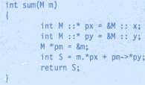
🞄 The pointer ip can now be used to access member m inside member functions (or friend functions), Let us assume that a is an object of A declared in a member function We can access m using the pointer ip as follows:
cout << a.*ip; // display
cout << a.m ; // same as above
Pointers to Members
🞄 Now look at the following code: ap= &a; // ap is pointer to object a cout<< ap-> *ip; // display m
cout << ap-> m; // same as above

Slide 68
🞄 Dereferencing operator->*----To access a member when we use pointers to both the object and the member.
🞄 Dereferencing operator.*----when the object is used (not
pointer to object) with the member pointer.
🞄 Note that *ip is used like a member name.
Pointers to Members
🞄 We can also design pointers to member functions which then, can be invoked using the dereferencing operators in the main as shown below:
🞄 (object-name .*pointer-to-member function)(argument);
🞄 (pointer-to-object ->* pointer-to-member function)
(argument);
🞄 The precedence of () is higher than that of .* and->*, so the
parentheses are necessary.

Slide 69
🞄 A constructor is a special member function whose task is to initialize the objects of its class. It is special because its name is same as the class name.
Constructors
🞄 The constructor is invoked whenever an object of its associated class is created. It is called constructor because it constructs the values of data members of the class.
🞄 The main job of a constructor is to allocate memory for class
objects.

Slide 70
class integer
{
int m, n;
public:
integer(void);
…………
};
integer :: integer(void)
{
m = 0;
n = 0;
}
Constructors
🞄 When a class contains a constructor like one defined above, it is guaranteed that an object created by the class will be initialized automatically. For example, the declaration
Integer int1; //object int1 created
🞄 Not only creates object but also initializes its data members m, n to zero. There is no need to write any statement to call constructor function.

Slide 71
🞄 The constructor that accepts no arguments is known as default
constructor The default constructor for class A is
A:: A( )
🞄 If no such constructor is defined, then the compiler supplies a
default constructor. Therefore a statement such as
A a;
🞄 Invokes the default constructor of the compiler to create the
object a.
Default Constructors
🞄 A default constructor is so important for initialization of object members, that even if we do not define a constructor explicitly, the compiler will provide a default constructor implicitly.

Slide 72
class Cube
{
public:
int side;
};
int main()
{
Cube c;
cout<<“The value is:”<<c.side;
}
In this case, if default constructor is not provided, then it can be provided by the compiler and will be called which will initialize object data members to default value.
Default Constructor Example
Cube()
{
side=10;
}
Default
Constructor

Slide 73
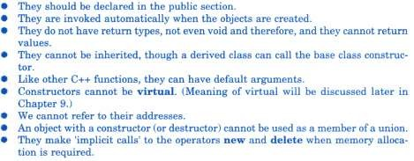
Special Characteristics of Constructor

Slide 74
different objects with different values when they are created.
🞄 The constructor can be used to initialized various data members of
🞄 C++ permits us to achieve this objective by passing arguments to the constructor function when the objects are created.
🞄 The constructor s that can take arguments are called
parameterized constructors.
Parameterized Constructor
class integer
{
int m, n; public:
integer(int x, int y);
…………
};
integer :: integer(int x, int y)
{
m = x; n = y;
}

Slide 75
🞄 When parameterized constructor has been defied
integer int1;//may not work,
🞄 we must pass the initial values as arguments to the constructor function when an object is declared. This can be done in two ways:
By calling the constructor explicitly.
By calling the constructor implicitly.
🞄 For Example
integer int1 = integer(0, 100); // explicit call
integer int1 (0 , 100) ; // implicit call
🞄 The second method is also known as short hand method (or
shorter), its looks better and is easy to implement.
Parameterized Constructor

Slide 76
integer( );
🞄 So far we have discussed two types of constructors
// no argument
// two arguments
Multiple Constructors in a class
integer(int , int );
🞄 In the first case, the constructor itself supplies the data values and no values are passed by the calling program.
🞄 In the second case, the function call passes the appropriate values from main(). C++ permits us to use both these constructors in the same case.

Slide 77
class complex
{
float x,y; public:
complex()
{
x=0;
y=0;
}
complex(float a)
{
x=y=a;
}
// Constructor No-argument
Overloaded Constructor Example
// Constructor One-argument
complex(float real, float imag) // Constructor Two-argument
{
x= real;
y= imag;
}
friend complex sum(complex c1, complex c2);
friend void show(complex c);
};

Slide 78
complex sum(complex c1, complex c2)
{
complex c3;
c3.x = c1.x +c2.x; c3.y = c1.y +c2.y; return (c3);
}
void show(complex c)
{
cout<<c.x<<" +j"<<c.y<<endl;
}
int main()
{
complex A(2.7, 3.5); complex B(1.6); complex C;
C = sum(A, B);
cout<<"A ="; show(A); cout<<"B ="; show(B); cout<<"C ="; show(C);
}
Overloaded Constructor Example
🞄 C++ compiler has an implicit constructor if no constructor defined in class, but once we define constructor then we must also include default constructor.

Slide 79
Example,
🞄 It is possible to define constructors with default arguments. For
complex (float real, float imag= 0);
🞄 The default value of argument imag is zero. Then the statement,
complex C (5.0);
🞄 assigns 5.0 to real and 0.0 to imag(by default).
🞄 However the statement
complex C (2.0, 3.0) ;
🞄 assigns 2.0 to real and 3.0 to imag.
Constructor with default argument

Slide 80
and the default argument constructor A::A (int=0).
🞄 It is import to distinguish between the default constructor A::A()
🞄 The default argument construct or can be called with either one
argument or no arguments.
🞄 When called with no arguments, it becomes a default constructor.
When both of these are used in a class it creates ambiguity for a
statement such as
A a;
🞄 The ambiguity is whether to call A::A() or
A::A(int=0)
Constructor with default argument

Slide 81
🞄 Parameter of constructor can be any type except that of the class to which it belongs.
🞄 However, a constructor can accept a reference to its own class as a parameter. Thus the statement,
🞄 For example
Copy Constructor
class A
{
……….
public:
A(A);
};
class A
{
……….
public:
A(&A);
};
//is illegal.

Slide 82
from another object.
🞄 A copy constructor is used to declare and initialize an object
🞄 For example,
integer I2(I1);
🞄 Would define the object I 2 and at the same time initialize the values of I1.
🞄 Another form of this statement is
integer I2=I1;
🞄 The process of initializing through a copy constructor is known as
copy initialization.
🞄 Remember
I2 = I1;
🞄 Will not invoke copy constructor.
Copy Constructor

Slide 83
🞄 However, if I 1 and I 2 are objects, this statement is legal and simply assigns the values of I1 and I2 member by member.
🞄 This is task of the overloaded assignment operator (=).
Copy Constructor
🞄 Difference between a copy constructor and an assignment
operator?
Copy constructor creates a new object which has the copy of the
original object .
On the other hand assignment operators does not create any new object. It instead, deals with existing objects.

Slide 84
🞄 Assignment operator is used to copy the values from one object to
another already existing object. For example:
time tm(3,15,45);
time t1; t1 = tm;
//tm object created and initialized
//t1 object created
//initializing t1 using tm
Copy Constructor Vs.
Assignment
Operator
🞄 Copy constructor is a special constructor that initializes a new object
from an existing object.
time tm(3,15,45); time t1(tm);
//tm object created and initialized
//t1 object created and initialized using tm object

Slide 85
class code
{
int id; public:
code()
{
}
code(int a)
{
id=a;
}
code(code &x)
{
id=x.id;
}
void display()
{
cout<<id;
}
};
int main()
{
code A(100); code B(A); code C=A; code D; D=A;
// copy constructor called
// copy constructor called
// D created, but not initialized
//copy constructor not called
Copy constructor example
cout<<"\nid of A:";A.display(); cout<<"\nid of B:";B.display(); cout<<"\nid of C:";C.display(); cout<<"\nid of D:";D.display();
}

Slide 86
🞄 We may create and use constant objects using const keyword before object declaration For example, we may create X as a constant object of the class matrix as follows:
🞄 const matrix X(m,n); // object X is constant
🞄 Any attempt to modify the values of m and n will generate compile time error.
🞄 Further, a constant object can call only const member functions.
🞄 As we know, a const member is a function prototype or function definition where the keyword const appears after the function’s signature.
🞄 Whenever const objects try to invoke non const member
functions, the compiler generates errors.
Const Object

Slide 87
by a constructor.
🞄 A destructor is used to destroy the objects that have been created
🞄 Like a constructor, the destructor is a member function whose
name is the same as the class name but is preceded by a tilde (~).
Destructor
🞄 For example, the destructor for the class integer can be defined as
shown below
~ integer( ) { }

Slide 88
value.
🞄 A destructor never takes any argument nor does it return any
🞄 It will be invoked implicitly by the complier upon exit form the program to clean up storage that is no longer accessible.
Destructor
🞄 Destructor can not be overloaded.
🞄 It is a good practice to declare destructors.

Slide 89
#include<iostream>
using namespace std;
int count=0;
class alpha
{
public:
alpha()
{
count++;
cout<<"\nNo. of objects created:"<<count;
}
~alpha()
{
cout<<"\nNo. of objects destroyed:"<<count; count--;
}
};
int main()
{
cout<<"Entered into MAIN"<<endl;
alpha A1,A2,A3,A4;
}
Constructor Example

Slide 90
Thank you

